Slide 1
Section 1.3 A Sip of Java: Outline
History of the Java Language
Applications and Applets
A First Java Application Program
Writing, Compiling, and Running a Java Program

Slide 2
History of Java
In 1991, James Gosling and Sun Microsystems began designing a language for home appliances (toasters, TVs, etc.).
Challenging, because home appliances are controlled by many different chips (processors)
Programs were translated first into an intermediate language common to all appliance processors.

Slide 3
History of Java
Then the intermediate language was translated into the machine language for a particular appliance’s processor.
Appliance manufacturers weren’t impressed.
In 1994, Gosling realized that his language would be ideal for a Web browser that could run programs over the Internet.
Sun produced the browser known today as HotJava.

Slide 4
Applications and Applets
Two kinds of java programs: applications and applets
Applications
Regular programs
Meant to be run on your computer
Applets
Little applications
Meant to be sent to another location on the internet and run there

Slide 5
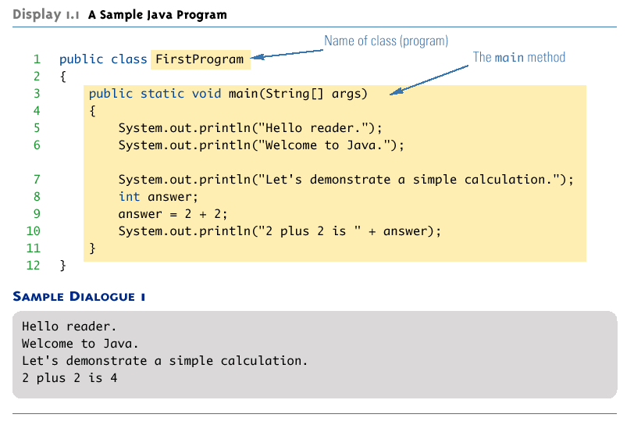
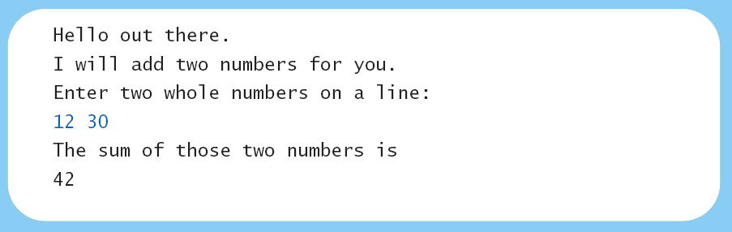
A First Java Application
View sample program Listing 1.1
class FirstProgram

Slide 6
[In Mac OS X Terminal window]
d-173-250-140-5:Code joe$ ls FirstProgram*
FirstProgram.java
d-173-250-140-5:Code joe$ javac FirstProgram.java
d-173-250-140-5:Code joe$ ls FirstProgram*
FirstProgram.class FirstProgram.java
d-173-250-140-5:Code joe$ java FirstProgram
Hello reader.
Welcome to Java.
Let's demonstrate a simple calculation.
2 plus 2 is 4
d-173-250-140-5:Code joe$
Program [only] computes 2 + 2 = 4. How can we make this more general?

Slide 7
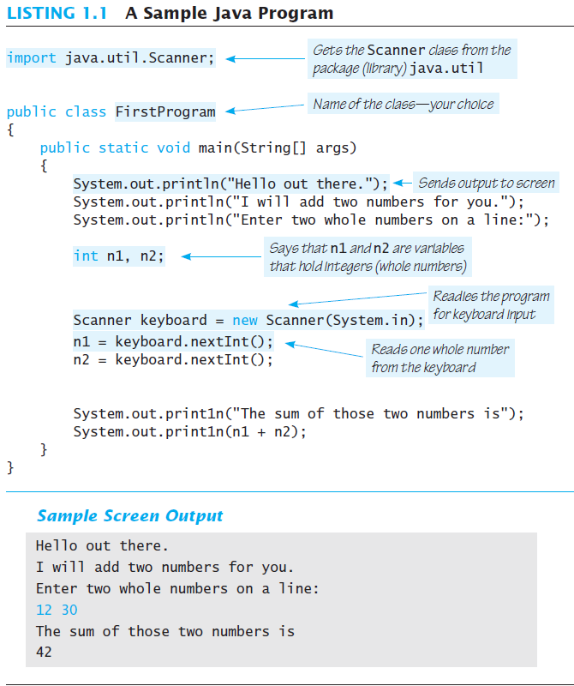

Slide 8
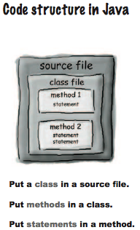
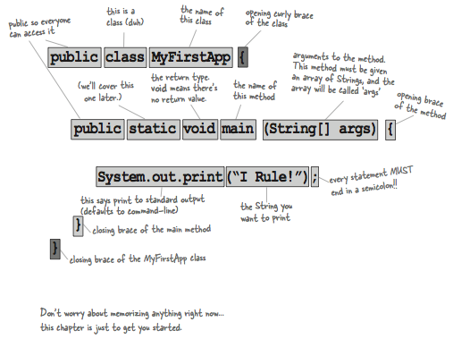
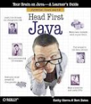
Java Programs

Slide 9
Some Terminology
The person who writes a program is called the programmer.
The person who interacts with the program is called the user.
A package is a library of classes that have been defined already.
import java.util.Scanner;

Slide 10
Some Terminology
The item(s) inside parentheses are called argument(s) and provide the information needed by methods.
A variable is something that can store data.
An instruction to the computer is called a statement; it ends with a semicolon.
The grammar rules for a programming language are called the syntax of the language.

Slide 11
Printing to the Screen
System.out.println (“Whatever you want to print”);
System.out is an object for sending output to the screen.
println is a method to print whatever is in parentheses to the screen.

Slide 12
Printing to the Screen
The object performs an action when you invoke or call one of its methods
objectName.methodName(argumentsTheMethodNeeds);

Slide 13
Compiling a Java Program or Class
A Java program consists of one or more classes, which must be compiled before running the program.
You need not compile classes that accompany Java (e.g. System and Scanner).
Each class should be in a separate file.
The name of the file should be the same as the name of the class.

Slide 14

Java
Goal:
Write once, run anywhere
JDK: Java Developers Kit
JRE: Java Runtime Environment
Editions
SE: Standard Edition
EE: Enterprise Edition
ME: Micro Edition (mobile, embedded)
Embedded: flash memory, closed systems
Versions
1.0 (1992), .. 1.6 (2006), 1.8 (2014)

Slide 15
Downloading Java [optional]
http://www.java.com/getjava/
Current: Version 8 update 40 (1.7u25)
On Mac, requires Mac OS X 10.7.3 or higher
We will be writing (developing) Java code, so we want JDK
Which includes JRE

Slide 16
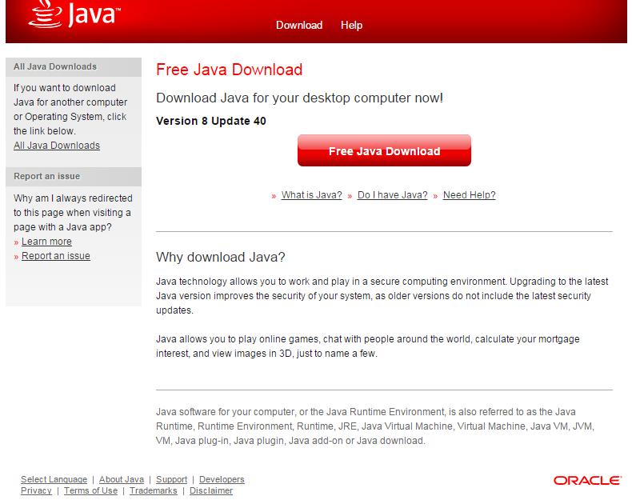

Slide 17
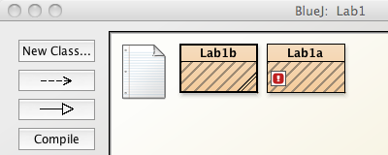


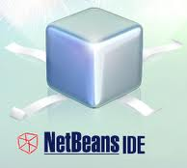
Integrated Development Environments (IDEs)
Programming tools
Edit text (code) + compile + run
Graphical representations of components
We’ll be using BlueJ, but you can use others
bluej.org
eclipse.org
netbeans.org

Slide 18
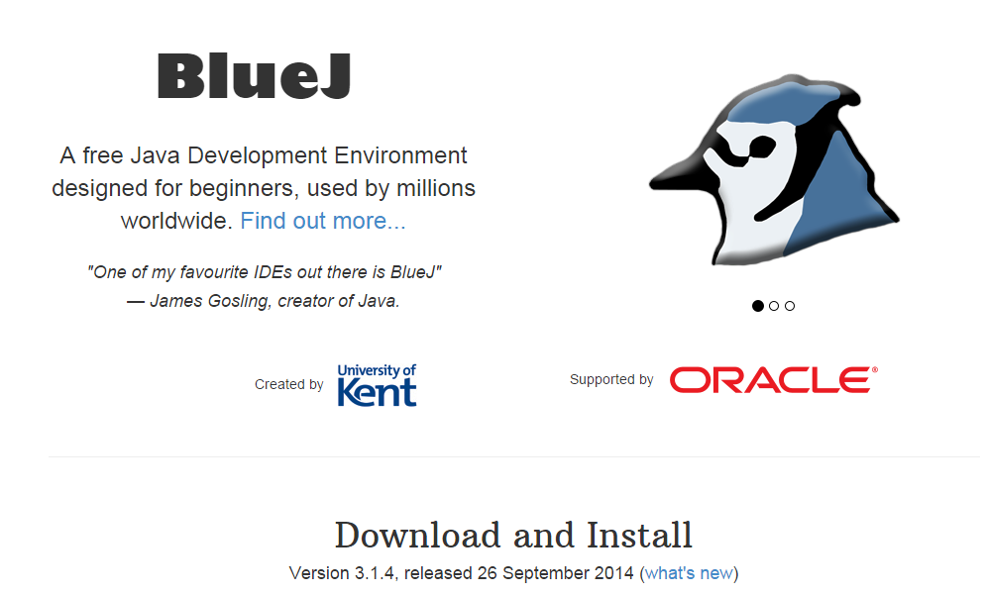
Downloading BlueJ [optional]
http://www.bluej.org/

Slide 19
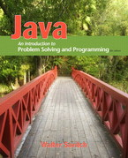
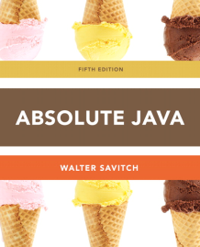
Next time (Monday)
Get textbook
Download Java and BlueJ (if needed)
Read:
Java: An Introduction…, (Savitch Notes) Sections 1.1-1.3
Absolute Java, Section 1.1 and 1.2
Using BlueJ (or other IDE), run sample Java program in display 1.1, FirstProgram
Complete Assignment A (Due Saturday)

